Slide 1
Welcome to Class 1-216
Ms. Marchia

Slide 2
Typical School Day
8:20- come into the classroom, unpack, and students check folders for notes
8:30- Morning Meeting- Read aloud/Shared Reading/Word Work
9:20- Reading Workshop/Independent Reading
10:10- Math
11:00- Writing Workshop
11:55- LUNCH/Recess
12:45- Science Lab
1:40- Social Studies/pack up
2:30- Dismissal

Slide 3
Other Activities During Our Day
Dance Time- throughout the day we get up and moving
Discussions- we share experiences we have had and stories
Songs- We learn songs to go along with our academics

Slide 4
Specials
Monday- Science Lab- Ms. Kay
Tuesday- Music- Mr. Malinofsky
Wednesday- Art- Ms. Dunbar
Thursday- Computer- Ms. Carson
Friday- Gym – Mr. LaRocca

Slide 5
Special Services
Mrs. Frangos- School Counselor
Mrs. Singleton- Social Worker
Ms. Stolburger- ESL Teacher
Mrs. Israel - Speech Teacher
Mrs. Scala- Special Education
Mrs. Ventoroutous- RTI
Mrs. Buzzini- School Psychologist
Mrs. Bidui- Occupational Therapist

Slide 6
Expectations
Your child is expected to:
Be respectful to everyone in and out of the classroom.
Clean up after him or herself (snack, desk, garbage on the floor)
Listen to directions and lessons being taught
Work with other students in partnerships and groups
Complete classwork and homework
Try their BEST ALWAYS!

Slide 7
Class Dojo
Sign up if you have not done so already.
Lets take a look!

Slide 8
Homework Folder
Folders are to be brought to and from school each day.
Please check your child’s folder everyday and take out anything that is not needed in school.
Checked math homework is to be left at home.
All notes and money should be labeled in an envelope with your child’s name on it.

Slide 9
Snack
Each day we have time for a small snack.
Please send your child to school with a healthy and easy to open snack.

Slide 10
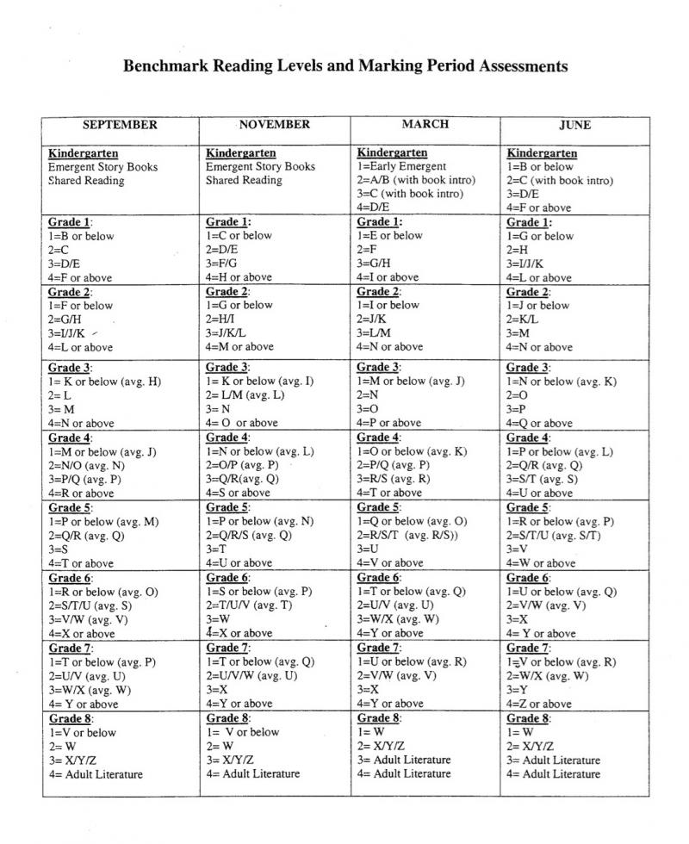
Reading

Slide 11
Book Baggies
Each student has a plastic book baggie with their name on it. This is baggie is filled with books for your child to read.
Each night book baggies are to be brought home and returned to school the next day.
Any lost or damaged books must be replaced.

Slide 12
Writing
Small moment stories
How-to books
Informational books
Book Reviews
Opinion Writing

Slide 13
Math
Addition
Subtraction
Word Problems
Number patterns
Number lines
Time
Shapes
Basic fractions
Data graphs

Slide 14
Social Studies
Families
School communities
Neighborhoods
Suburban, urban, and rural areas
Continents
Oceans
Map skills

Slide 15
Science
Three main areas
Animal Diversity
Properties of Matter
Weather and Seasons
Science Textbook website:
www.hspscience.com
Find eproducts- click Log in
Username: nyork11
Password: science

Slide 16
Birthdays!
Send me a message on Class Dojo a week in advance.
Cupcakes, snacks, goodie bags

Slide 17
Dismissal
2:30 is dismissal time for 1st grade
If you need to speak to me after school I ask that you set up a meeting with me on Tuesday between 2:40- 3:10.

